Slide 1
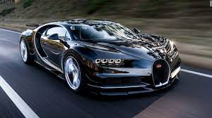
Alset IoT
“Hugs the Lanes”

Slide 2
Use IoT to make cars safer, less costly, and more efficient
Use IoT to make decisions or provide information to the driver
Use IoT edge devices that can capture data from the car and environment
Use an analytic engine (IoT Engine) on board to process information and make decision that is passed on to the Car Control System (CCS)
Provide capability for the driver to enter commands and receive status
Download the latest rules and updates for operation from the Fog/Cloud into the IoT Engine
Upload the car data to the company cloud.

